Slide 1
ООП и JavaScript
Notes:
Hi there!
I’m Martin. You know guys when you start working on a project and you have a working title. It’s not the final one, but the one you use to explain what you are doing. Well … this is the working title that actually got to production ☺
A few words about the “mad guy”

Slide 2

Кой съм аз?
Софтуерен архитект
Технически ръководител по клиентски софтуер
Технологичен ентусиаст
Дизайнер на софтуер
Notes:
Post presenting myself…:
Actually in these 4 words (state the words) there is quite a lot of stuff, so let’s split them a bit and start by understanding what inheritance really means.

Slide 3


Slide 4
Наследяване
Notes:
Please note I am not speaking about classes, just relationships.

Slide 5

Notes:
This might be the best kind of inheritance … I wish it upon you all! So now let’s go to classical!

Slide 6
A
B
Notes:
Single inheritance
where subclasses inherit the features of one superclass. A class acquires the properties of another class.
Good example:

Slide 7
A
B
C
Notes:
Multilevel inheritance
where a subclass is inherited from another subclass. It is not uncommon that a class is derived from another derived class as shown in the figure "Multilevel inheritance".
The class A serves as a base class for the derived class B, which in turn serves as a base class for the derived class C. The class Bis known as intermediate base class because it provides a link for the inheritance between A and C. The chain ABC is known as inheritance path.

Slide 8
C
A
B
Notes:
Hierarchical inheritance
where one class serves as a superclass (base class) for more than one sub class.

Slide 9
A
C
B
Notes:
Multiple inheritance
where one class can have more than one superclass and inherit features from all parent classes.
Horse + Man => !Centaur

Slide 10
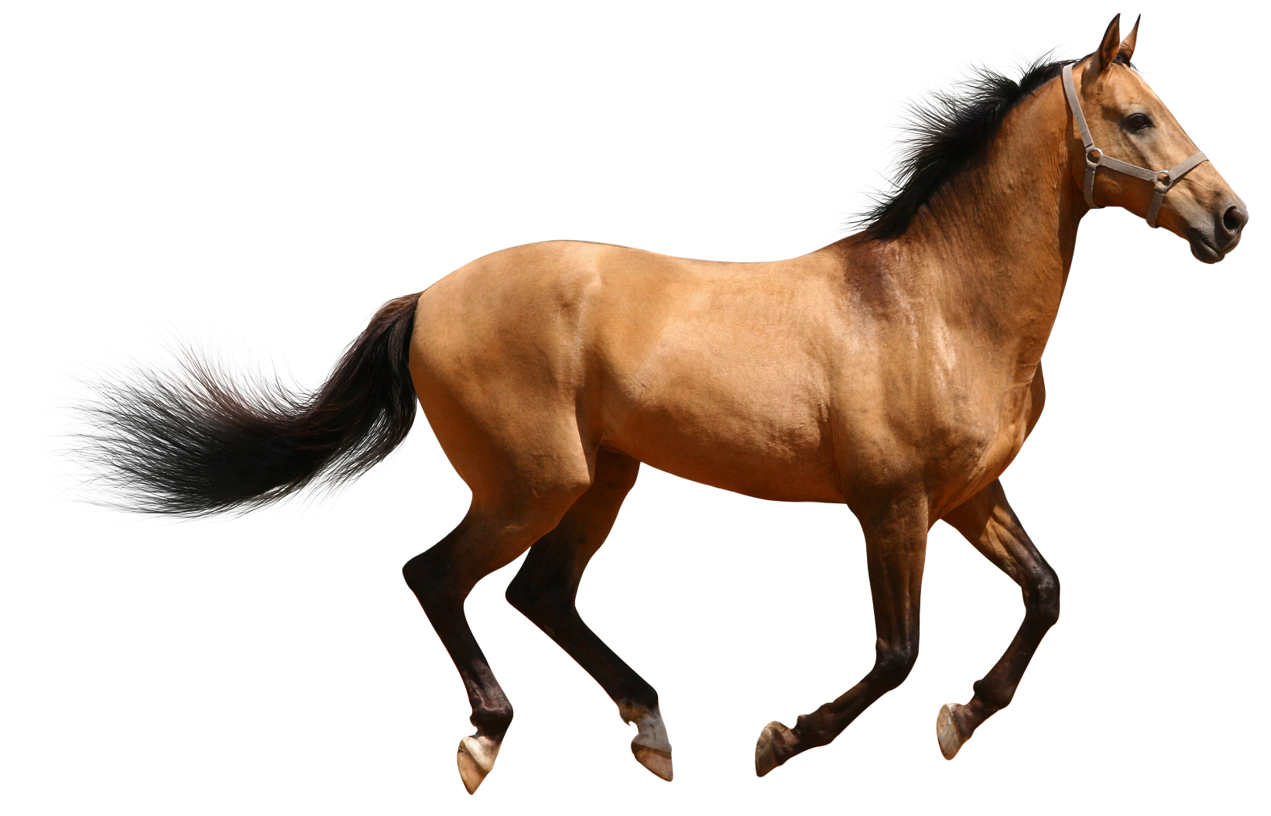


Slide 11
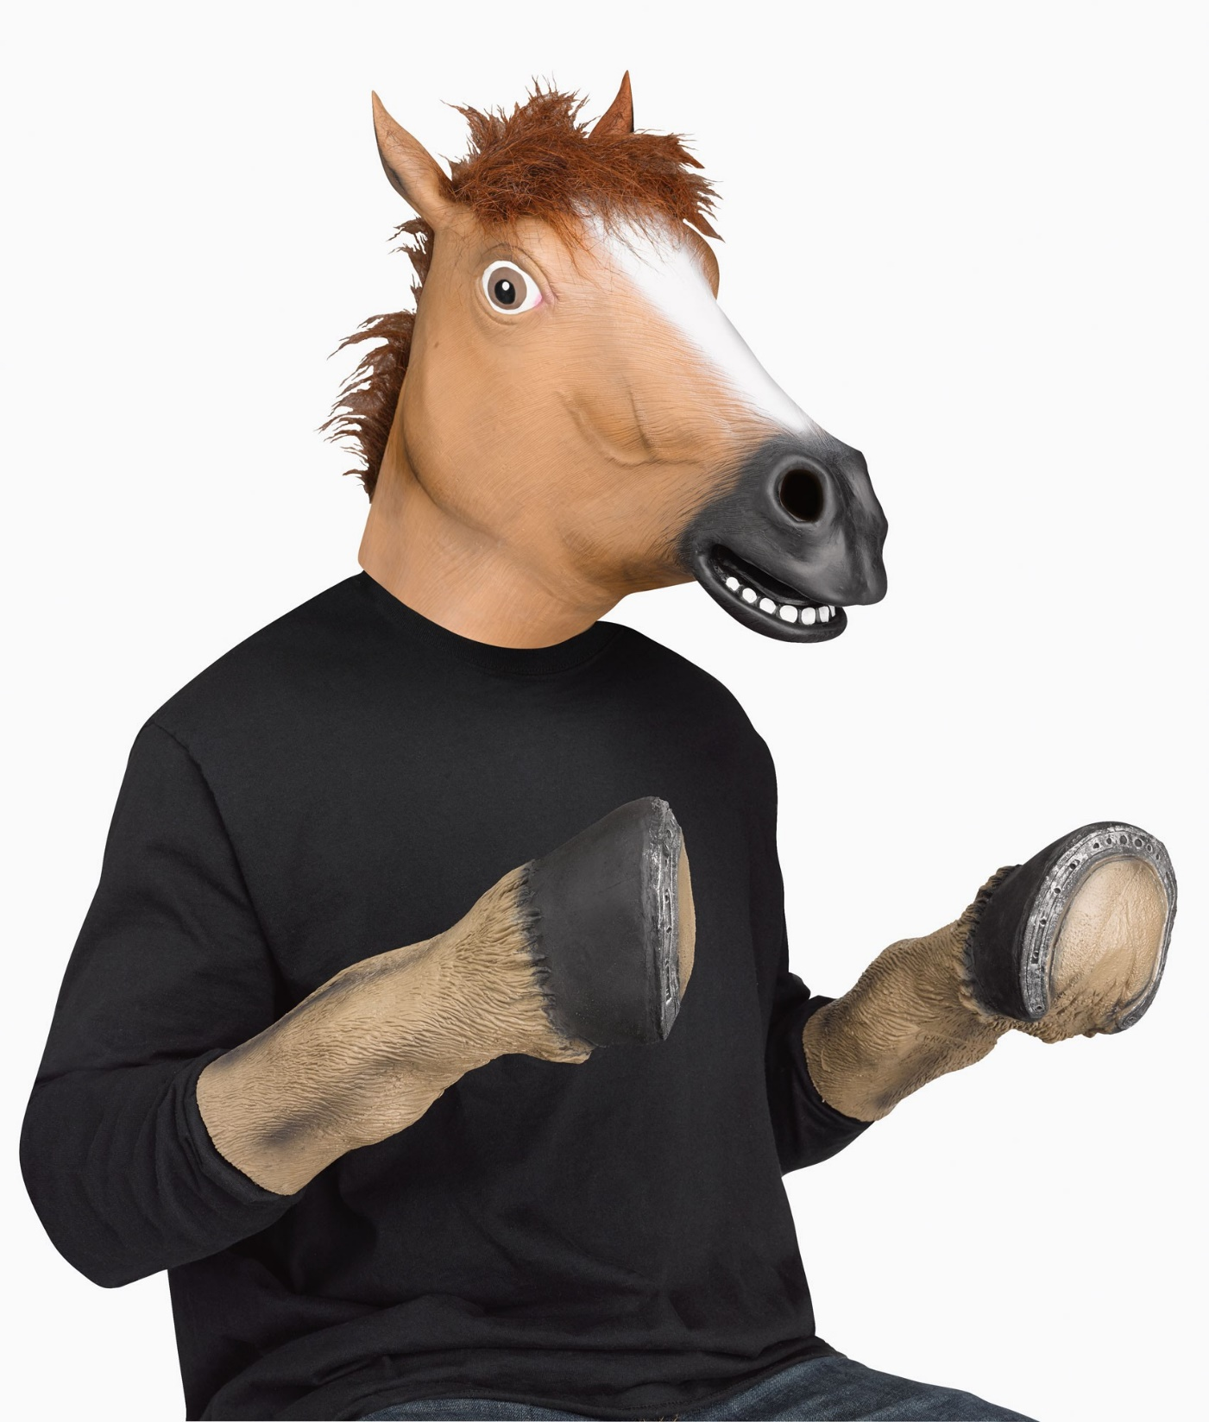

Slide 12
A
B
AB
C
D
E
F
G
H
Notes:
Hybrid inheritance
a mix of two or more of the above types of inheritance.
Usually where our projects get the need of massive re-factoring…

Slide 13
Прототипно ООП

Slide 14
Класическо ООП

Slide 15
Свързани обекти

Slide 16
Композиция

Slide 17
Засенчващи свойства

Slide 18
Интроспекция

Slide 19
Резюме
Наследяване
Класическо ООП
Прототипи
Делегиране
Свързани обекти
Композиция
Засенчващи свойства
Интроспекция

Slide 20


Slide 21


Slide 22

Контакти ☺
LinkedIn: https://goo.gl/CRRJ2Y
Mail: martin.c@sbtech.com
Github: https://github.com/mchaov

